Slide 1

securing iot
Human activity recognition
21.11.25

Slide 2
What is IoT
Internet of Things realises an adaptive complex network that connects devices, or "things" to the internet via standard communication protocols.
IoT utilises a level of digital intelligence, using sensors and mechanisms to interact with the environment to communicate real-time data.
Notes:
IoT creates an adaptive complex network. This connects devices that have "digital intelligence" - through sensors and mechanisms to interact in real time

Slide 3
Benefits of IoT
Customer Experience Improvement
Data Collection
Predictive Maintenance
Cost Reduction
Productivity Increase
Notes:
JAKE SLIDE
Utilising IoT devices allows us to create personalised experiences by understanding how customers use our products in realtime meaning we can tailor features to their need
Devices constantly feed us with insights that traditional data collection cant capture
IoT devices also allow us to detect minor issues before they evolve into major failures
Although upfront initialisation costs can be eye watering, optimised processes slash operating costs and result in a more efficient bottom line
Automation allows for measurable increases in overall output and efficiency

Slide 4

The Idea
IoT Devices have sensors to provide LOADS of data
Data can be leveraged for surveillance purposes
Prevent major crime
Idea comes from anti-terrorism
Notes:
Jake
Our project addresses the need for proactive crime prevention, we’re utilising real time data to predict incidents before and during the time theyre happening
We utilise IoT devices to collect real time movement and presence data, creating a map of normal activity
Using multiple ai/ml algorithms we can establish normal patterns and through that detect significant deviations

Slide 5
Phases
Data Collection
01
Machine Learning & Deep Learning
02
Results Visualisation and Comparison
03
Ethical Considerations & Future Implications
04
Notes:
Scott
The project comes with the idea of four distinct phases.
Starting with Data Collection, where we obtain walking, running, driving and other data.
Then going onto Machine Learning and Deep Learning, where we code the actual algorithms and convert all data into a single common format.
And after that is complete, we move onto obtaining results, visualising them and comparing the models.
Before finally looking at the ethical considerations and future implications

Slide 6
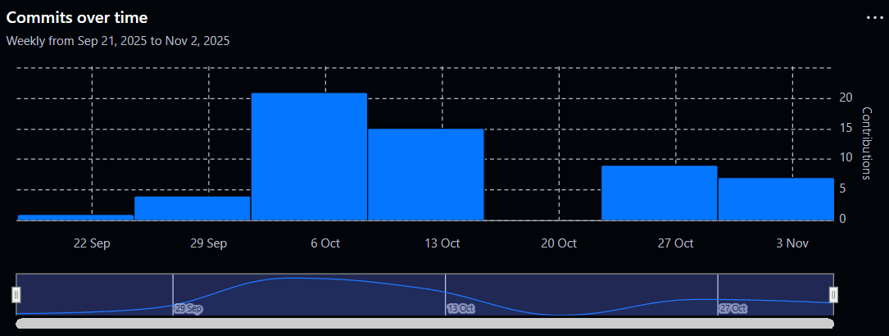
Project Management
The project has been split up with 'Leads’:
ML/DL Lead
Data collection Lead
Results & Visualisation Lead
Ethics & Security Lead
Documentation Lead
All members still had to participate in each other’s activities
Progress was tracked via GitHub
Notes:
Scott
ML/DL lead – create and train algorithms to predict human activity from data gathered.
Data Collection lead – manage public and group data, ensure data gathered by group is in a consistent format to be used for the algorithms.
Results & Visualisation lead – use performance metrics to create graphs and visualisations for the presentation.
Ethics & Security lead – Consider potential ethical and security concerns of the project.
Documentation lead – Ensure documentations and presentation are completed for the deadline.

Slide 7
Data collection

Slide 8

How the data was collected
Data was gathered through 6 phones using the Tracks logger (Apple) and GPS logger (Android) apps.
The activities recorded include sitting, walking, running, driving and train travel.
The data was gathered across the UK but mostly came from Somerset and the west midlands.
Notes:
Jack
2 apps both published by the same developer to different platforms. Data was exported in different formats so a preprocessing stage for data was required to ensure our dataset had normalized data across all entries.
The activities we selected aim to match common movements of an average person in their day to day lives.
The amount of data isn’t huge considering the system we are suggesting but it provides proof of concept and is more than enough to train the models and evaluate their performance.
Ho, Peter (2024) GPS Logger (4.4.95) [Mobile App]. Available at: https://play.google.com/store/apps/details?id=com.peterhohsy.gpsloggerlite (Accessed: 29 September 2025).

Slide 9
Problems with data collection
While collecting data we encountered some issues…
Discrepancies with sitting data
Loss of GPS signal
App limited the rows of data that can be recorded
Notes:
Jack
When stationary, the app should show an average speed of 0. However, issues with inaccurate GPS meant that the apps tracked erroneous movements.
Certain enclosed areas had very poor GPS signal leading to data showing sudden jumps in speed detected when GPS signal was restored. To solve this, we sorted the data at the preprocessing stage to check for these irregularities.
The apps had maximums for the data that could be recorded, meaning we had to regularly export data to ensure none was lost.

Slide 10
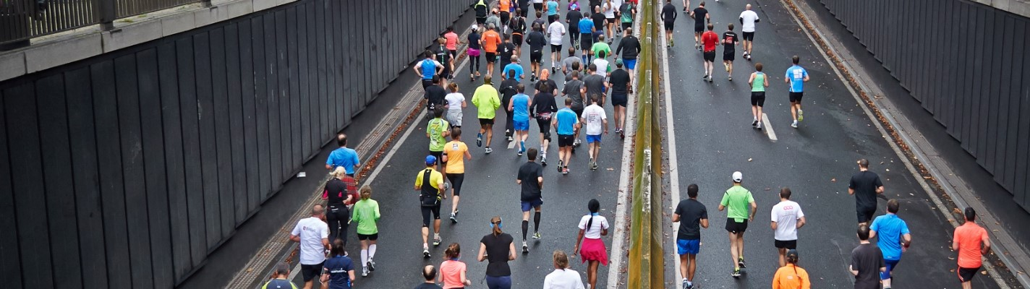
Public Dataset: Run or Walk
We chose the Run or Walk dataset, containing labelled sensor data for different types of movement.
Due to differences in formatting, we created a python script to make the public dataset comparable to our gathered data.
Notes:
Jack
The dataset we chose is from a publicly available deep learning project called Run or Walk at Kaggle.com. It’s a mixed movement dataset meaning at different points throughout the data, the individual goes from walking to running – allowing classification of both types of movement.
We also used a European train station dataset that provides GPS coordinates of all train stations in Europe. This allowed for location verification through our gathered data to confirm if someone was travelling by train.
Malyi, V (2017) Run or Walk. Available at: https://www.kaggle.com/datasets/vmalyi/run-or-walk (Accessed 28 September 2025).
Prata, M. (2020) European Train Stations Maps. Available at: https://www.kaggle.com/code/mpwolke/european-train-stations-maps/input (Accessed 28 October 2025).

Slide 11
Algorithms

Slide 12


ML Algorithm 01 – Random Forest
Performed prediction on labelled data based on a group of decision trees
Ideal scenarios:
Robust against large datasets
Resilient to noise when some fields are invalid or use NaN values
Note: could be further optimised with parameters 'min_sample_split' and 'class_weight'
Number of trees in RF. '200' offers a stable amount of predictions
Number of splits – 8 enables it to capturing more complex patterns
Notes:
Josh White
In this model, the Random Forest creates 200 decision trees. Each tree is trained on random parts of the data and uses different values for each features at each step. This helps the model learn different patterns in the data that relate to activities like walking, running, being on a train or in a vehicle. When the model needs to take a prediction. It will takes a majority vote from all 200 trees then the final label is assigned
Random Forest Classification in Python With Scikit-Learn: Step-by-Step Guide (with Code Examples). Available at: https://www.datacamp.com/tutorial/random-forests-classifier-python (Accessed: Nov 19, 2025).
Lower max depth if the features are simple and improve performance. Increase if results are too
simplistic
https://scikit-learn.org/stable/modules/generated/sklearn.ensemble.RandomForestClassifier.html
What Is Random Forest? | IBM

Slide 13
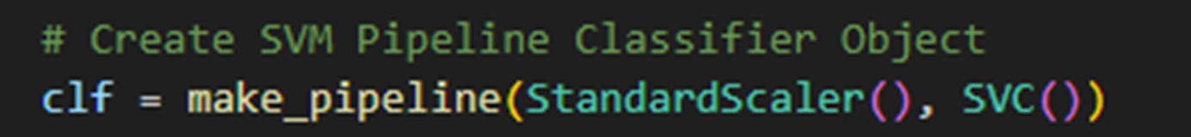

ML Algorithm 02 – SVM
SVM model finds the best possible boundary (or hyperplane) between different activities
Ideal scenarios:
For smaller datasets
Uses a StandardScaler ensures speed values are on a consistent scale, helping SVM draw a boundary between walking and running classifications.
Note could be further optimised with parameters 'C', 'kernal' and 'gamma'
Notes:
Josh White
This model works by finding the best possible boundary or hyperplane that separates different activity types, such as walking, running, and being in a vehicle.
A Standard Scaler ensures speed feature values are treated fairly. Without scaling the model sees big gaps and might struggle to set fair boundaries.
SVM Hyperparameter Tuning using GridSearchCV - ML(2019) Available at: https://www.geeksforgeeks.org/machine-learning/svm-hyperparameter-tuning-using-gridsearchcv-ml/ (Accessed: Nov 19, 2025).

Slide 14






Coding conventions to improve accuracy
Rolling average of speed calculated over 5-samples
Uses reverse interaction on the dataset to correct travel transitions
Train travel detection using GPS nearest station proximity (Using Haversine distance formula).
KEY
km/h
0 - 1
HOME
UNI
2 - 7
Without reverse iteration
8 -18
Chippenham station
Bath
station
19 - 72
UNI
HOME
73+
With reverse iteration – between GPS coords for railway stations
Notes:
Josh White
When the model makes its first prediction from the datasets a second pass over the data is implemented however is goes backwards on the data correcting incorrect transitions. Where the model thinks that the person is walking when actually they are driving slowly. In addition with haversine distance formula I was able to calculate the distance between GPS points. This allowed me to calculate the distance between train stations and the users GPS data. From this, then I could find the nearest station and check if the user was catching the train correcting incorrect fields when the user was in-between stations. The model also is improved with a rolling average over 5-samples, which takes the average over 5 samples making patterns much cleaner, offering more accurate results .

Slide 15
DL Algorithms – LSTM and CNN
LSTM model learns sequential patterns and remembers previous steps (like past speed changes) to identify trends such as speeding up or slowing down. Typically used in text prediction
CNN model uses layers to looks for patterns in short windows typically used in image recognition
PyTorch handles all the AI calculations and feeds the data in batches which allows the model to process multiple sequences at once - training it faster and efficiently
Epochs allows the model look at the data multiple times improving its learning and accuracy
Uses Standard Scaler to rescale features such as speed
Notes:
Josh White
LTSM stands for Long Short-Term Memory,
The LSTM model is great for time series or sequential data (in our case, sample data collected over time) In our model, the LSTM looks at small chunks of data called sequences and remembers previous steps or patterns. This memory helps it identify trends in activities, such as walking, running, or being in a vehicle, by connecting what happened in the past with the current data
Convolutional Neural Network. Typically used to look for patterns in the sequence. Our cnn model is 1D
The CNN layers extract features from these sequences using convolution and pooling layers
FOR CONVOLUTION
At each Conv1D layer extracts and scans over sequences readings of speed, latitude, longitude. The first layers detect simple patterns i.e (a single speed spike indicating running), with deeper layers detecting more complex patterns like the transition from walking → running → in_vehicle.
What Is a Convolutional Neural Network? Available at: https://www.mathworks.com/discovery/convolutional-neural-network.html (Accessed: Nov 20, 2025).
FOR POOLING
after convolution it. Pooling Compresses the features into small windows. Keeping the most important movement patterns and discarding small irrelevant patterns.

Slide 16
Results Visualisations

Slide 17
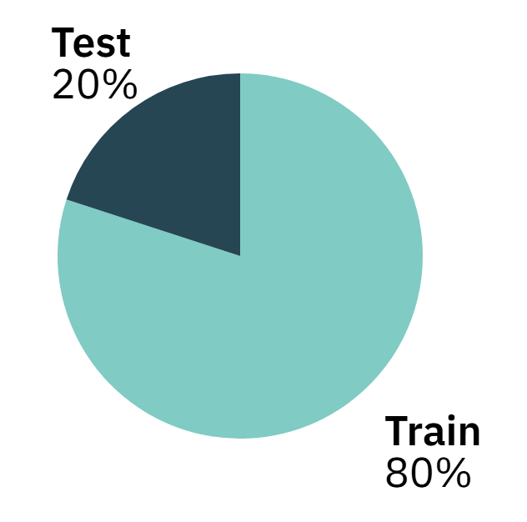
Train / Test Split
80/20 split across all algorithms
Standard 80/20 split to help with overfitting
gives an unbiased estimate of model performance
80% towards training
Used to teach each algorithm the patterns and relationships in the data
20% towards testing
Used to evaluate how well the model generalizes to unseen data.
The same split was applied so that results remain comparable across all learning approaches giving a fair comparison
Notes:
Scott
used a consistent 80/20 train–test split, this is a standard practice in machine learning and helps reduce overfitting by ensuring the model doesn’t just memorize the training data.
Using this split provides an unbiased estimate of the model’s performance, because we evaluate it on data it hasn’t seen before.
80% of the data was allocated to training.
This portion is what each algorithm uses to learn the underlying patterns and relationships within the dataset.
The remaining 20% was used for testing.
This allows us to measure how well each model generalizes to new, unseen data, which is critical for assessing real-world performance.
Applying the same split across all algorithms ensures that the comparison between models is fair and consistent.
Each model is evaluated under the exact same conditions, which strengthens the validity of the performance comparison.

Slide 18
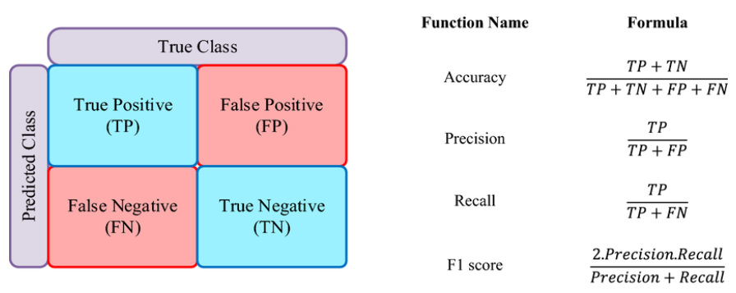
Performance metrics
To evaluate the performance of our models, we used the following metrics:
Accuracy: A fundamental metric that shows you the overall proportion of correct predictions made by the model.
Precision: This measures how many positive predictions made by the model were correctly classified.
Recall: From all actual positives, this measures how many were correctly predicted.
F1-Score: This is the mean of Precision and Recall - giving a balanced view of the models effectiveness.
Notes:
scott
Accuracy can be misleading in imbalanced datasheets but is a good basic overview of the models .
Precision and Recall can help understand which activities the model performs well on. Precision focuses on quality of positive predictions, while recall looks at capturing all real positives.
F1-score gives a single balanced view of model performance using Precision and recall.
Table available at : https://www.researchgate.net/figure/Confusion-matrix-and-performance-metrics-formula_fig3_370070277
Raihan, M.J., Khan, M.A., Kee, S-H. and Nahid, A. (2023) Detection of the chronic kidney disease using XGBoost classifier and explaining the influence of the attributes on the model using SHAP. Scientific Reports, 13, p. 10.1038/s41598-023-33525-0.

Slide 19
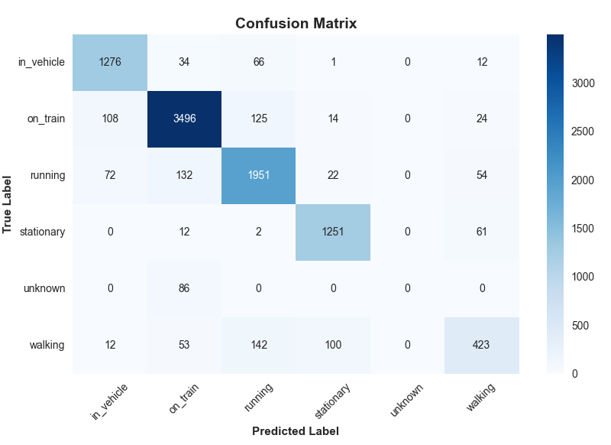
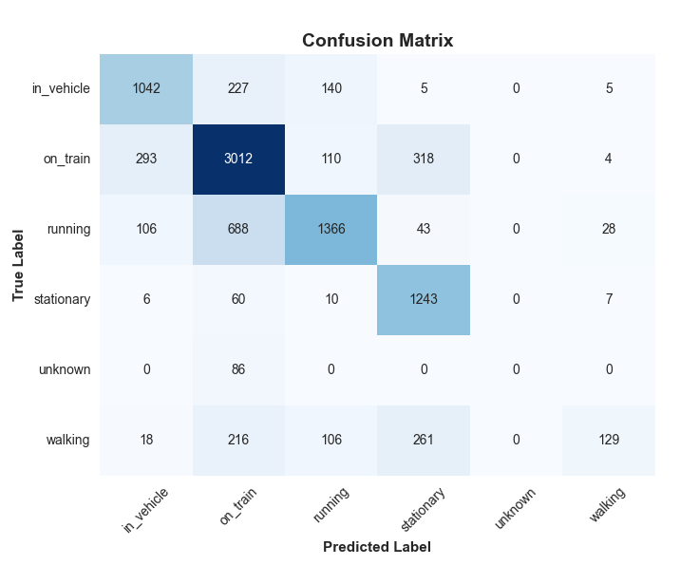
ML Algorithms – Confusion Matrix
Random Forest
SVM
Notes:
RF
Overall Accuracy: 0.9010 Precision: 0.8941 Recall: 0.9010 F1-Score: 0.8972
SVM
Overall Accuracy: 0.7324 Precision: 0.7298 Recall: 0.7324 F1-Score: 0.7256

Slide 20
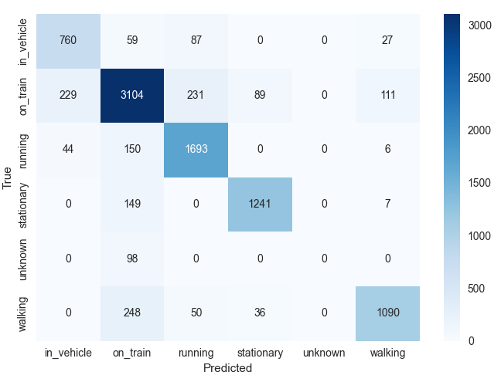
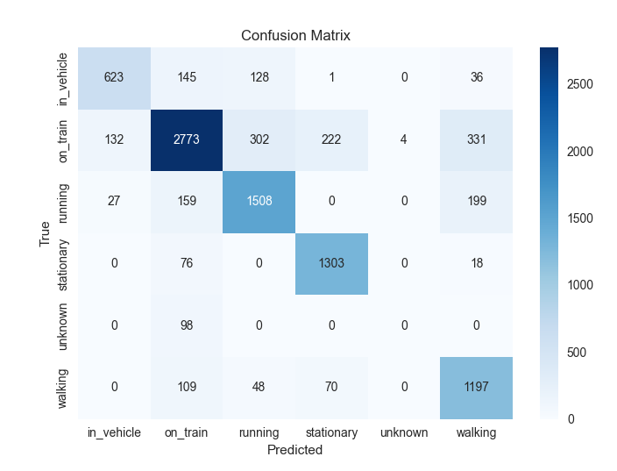
DL Algorithms – Confusion Matrix
LSTM
CNN
Notes:
CNN Overall Accuracy : 0.8016 Precision: 0.7976 Recall : 0.8016 F1 Score : 0.7982 LSTM Overall Accuracy: 0.9579 Precision: 0.9583 Recall: 0.9617 F1 Score: 0.9645

Slide 21
ML vs DL Algorithms
Machine Learning: Random Forest had higher accuracy (0.9010 vs 0.7324), precision (0.8941 vs 0.7298), recall (0.9010 vs 0.7324) and F1-score (0.8972 vs 0.7256) compared to SVM
Deep Learning: LSTM had higher accuracy (0.9579 vs 0.8016), precision (0.9583 vs 0.7976), recall (0.9617 vs 0.8016) and F1-score (0.9645 vs 0.7982) compared to CNN
Comparison: LSTM had higher accuracy (0.9579 vs 0.9010), precision (0.9583 vs 0.8941), recall (0.9617 vs 0.9010) and F1-score (0.9645 vs 0.8972) compared to Random Forest
Comparison: SVM and CNN were the lowest-performing models, with SVM showing lower accuracy (0.7324 vs 0.8016), precision (0.7298 vs 0.7976), recall (0.7324 vs 0.8016) and F1-score (0.7256 vs 0.7982) compared to CNN
Notes:
Josh green Looking at the results you can see that RF was the best performing ML model beating out SVM and LSTM was much better than our other DL model was also the best performing model overall. This was then followed by RF, CNN and finally SVM
SVM
Overall Accuracy: 0.7324 Precision: 0.7298 Recall: 0.7324 F1-Score: 0.7256
RF
Overall Accuracy: 0.9010 Precision: 0.8941 Recall: 0.9010 F1-Score: 0.8972
CNN Overall Accuracy : 0.8016 Precision: 0.7976 Recall : 0.8016 F1 Score : 0.7982
LSTM Overall Accuracy: 0.9579 Precision: 0.9583 Recall: 0.9617 F1 Score: 0.9645

Slide 22
Results Overview
Random Forest was the best ML algorithm, LSTM was the best DL algorithm
However, LSTM had a much higher execution time, whilst also being much more resource-intensive
Random Forest provides a good balance of being quick to run and higher metric scores
Therefore, Random Forest might be the best algorithm for production. Slower execution could mean slower response times!
Notes:
Josh green
RF better in real world as quicker and less intensive as it requires data to be analysed quickly – unless supercomputers but sheer scale alone would require immense power so probably not a good real world use for LSTM
Random Forest was the strongest ML model, giving high accuracy while staying efficient.
LSTM was the strongest DL model overall, but required far more computing power and time.
LSTM’s higher resource use makes it less practical for real-time IoT environments.
Random Forest gives a better balance of speed and performance for deployment.
In production, faster models like Random Forest help avoid delays in activity detection.

Slide 23
Ethics & future implications

Slide 24
Future Developments
Real-Time Predictions
GPS Mapping (to see the hotspots of times)
Mobile-Phone-Based Background Service App
Azure Cloud to Achieve Future Developments
Notes:
Sam
Future developments go beyond the scope of this experiment.
We only ran through a piece of what we would be working with for a production-like project
And so our future developments include real-time predictions, GPS mapping, remote ML and a background service app to be installed on all mobile phones.
This leads me into my next point of how it is going to work.

Slide 25
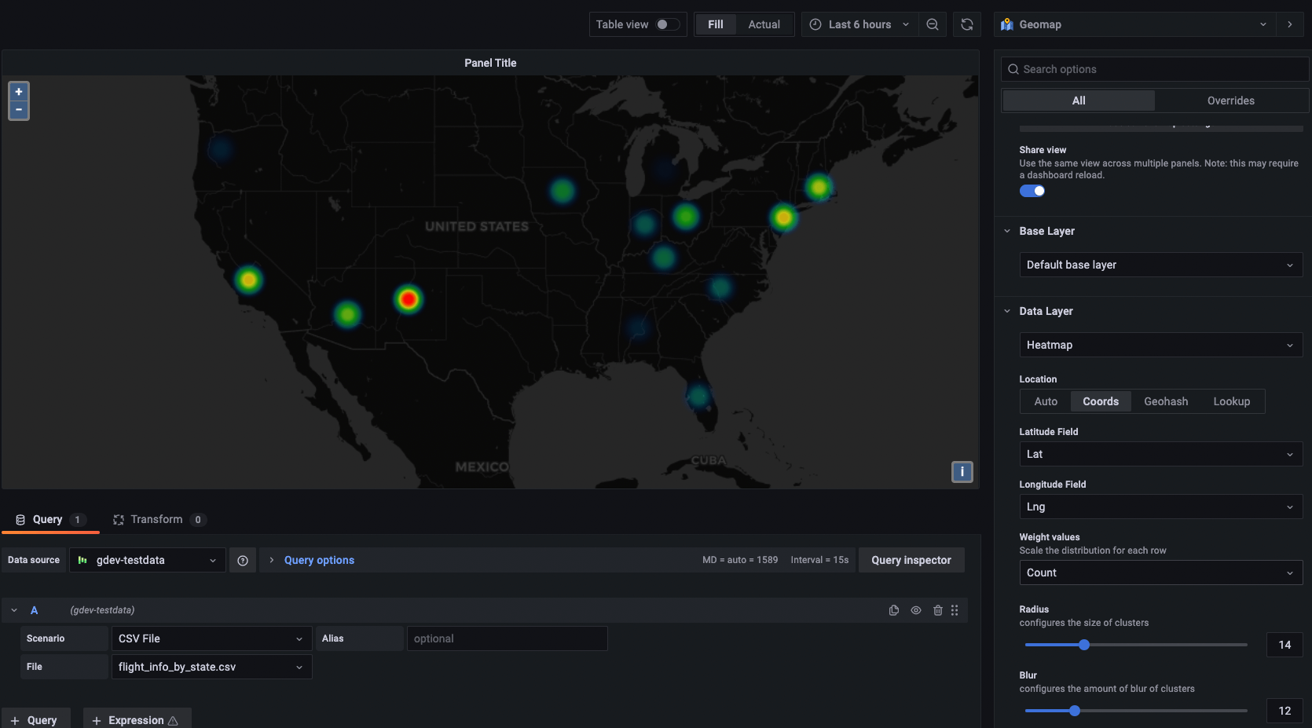
Example of Azure Managed Grafarna Capability
High probability area highlighted in red
Grafana Labs. 2021. “What’s New in Grafana 8.1: Geomap Panel”. [online] 17 August. Available at: https://grafana.com/blog/2021/08/17/whats-new-in-grafana-8.1-geomap-panel/ [Accessed 2 November 2025].
Notes:
Sam
So this is Azure Managed Grafarna, it's a cloud data visualisation platform.
When considering the future developments and making our project ready for deployment, this is absolutely a requirement.
It shows how our project will work if it was to be rolled out, on occasions where activity has built up (e.g. multiple people running away from a single area in different directions), the heatmap over a geographic location will go red, depending on the likelihood that an event has taken red.
High probability of an incident for example is red, flagged up because it's lighting up red. So this might be a terrorist incident and we can send someone there directly saving some time before someone phones emergency services.
Grafana Labs. 2021. “What’s New in Grafana 8.1: Geomap Panel”. [online] 17 August. Available at: https://grafana.com/blog/2021/08/17/whats-new-in-grafana-8.1-geomap-panel/ [Accessed 2 November 2025].

Slide 26
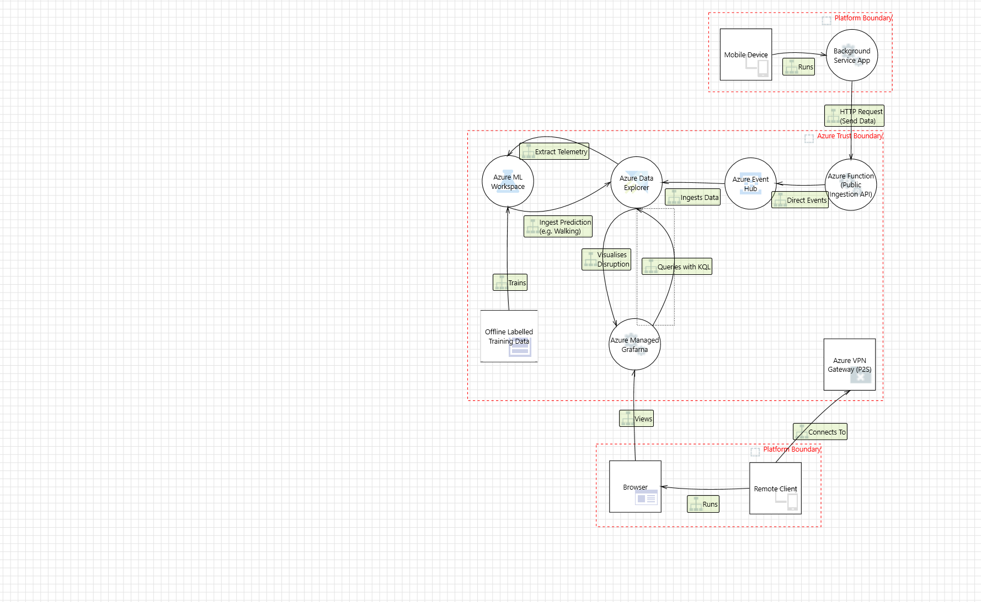
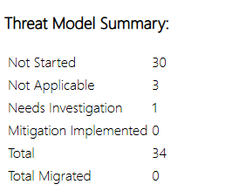
Threat Model – Cloud Visualisation
Device uses a background service app
This sends HTTP JSON data to a public Azure Function
The Azure Function will forward non-malformed requests to the Event Hub for ingestion into an 'ADX Cluster'
Think of ADX as a massive central database
This is accessed by ML or DL to ingest predictions before visualising to Grafarna on a large map
Hidden Background Application
The key part about this is Azure Managed Grafarna
This is monitored by dispatchers and law enforcement
Via Internal VPN and Entra ID Role-Based Access
Notes:
Sam
This leads me to the threat model - I've created this for two reasons.
One, so that we can see how the full-scale application would work
and two, to see the potential security vulnerabilities
You can see the mobile device runs the app, which contacts the runs a background service to constantly send GPS, acceleration data, etc.
This data is sent to an azure function, which accepts input requests in a certain form – if it's not in the right format or looks suspicious, the data will be dropped.
If the data looks legitimate – e.g. in the right format, not from a blocked device, it will go through to event hub.
Note that we're using event hub because we'd be dealing with possibly billions of data per second, and whilst we have ADX with massive ingestion cability, we need Event Hub for traffic control.
ADX is also contacted by an ML workspace, note that this does not restrict us from using DL models, though the choice between ML and DL depends on cost.
Once AI has made a prediction if the person is running, walking, on train or whatever, Grafarna queries the data in real time with Kusto Query Language (KQL)
Then this can be viewed by a remote client with an internal VPN.

Slide 27
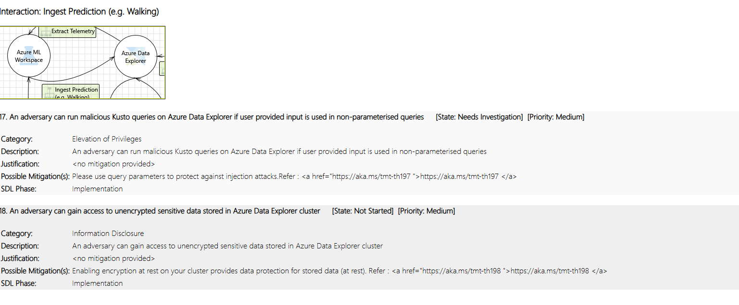
Threat Report Examples
Notes:
Sam
You can also see some of the threats driven from this model.
In total, there were 31 threats we need to look at, with different set priorities and states.
Whilst some have been mitigated, this already provides us with an idea of how we can further secure it.
If this data is leaked, think of the consequences.

Slide 28
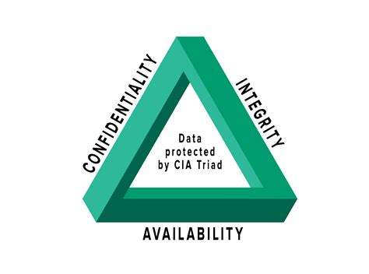
Data handling concerns
CIA Triad used for guidance:
C - Personal GPS data kept private on GitHub
I – Verified data integrity after preprocessing
A - GitHub primarily used, with shared backups via OneDrive
Notes:
Jack
At this stage, there were a few ethical and security concerns…
For data handling/ storage – we used guidance of CIA
C – data had our personal geolocation data, was stored in a private GitHub repository.
I – while we edited some formatting of the .csv files, we tried to ensure none of the actual data was changed. As a backup, we had the raw files stored.
A – GitHub was used for organization of the project due to their high standing as a version management system, however in the event of server issues we had both local and cloud backups for all key files
Walkowski, D. (2019) What is the CIA Triad? Available at: https://www.f5.com/labs/articles/what-is-the-cia-triad (Accessed 9 November 2025).

Slide 29
Ethical Concerns - Individuals
For many users, rollout of our project may be too privacy invasive.
False alarms may waste the time of Law Enforcement
False data can be created deliberately by forging requests
Is this data being used for other purposes
Notes:
Josh Green One option could be an opt out? Such as how it is with organ donation etc The data could be at threat of being sold to advertising companies to give realtime ads based on location etc – location data of everyone everyday would be highly profitable and if not kept under a strict ruleset around the usage could lead to it being sold to the highest bidder / stored on their servers
Some people may feel uncomfortable with sharing their location or movement data all of the time. Even with anonymised data, it can still reveal personal habits and daily routines.
If the system makes a mistake or incorrectly classifies an event, it could lead to unnecessary alerts which would waste police resources and reduce trust in the system.
Attackers could send fake IoT data which could trick the system. This could cause confusion and could also be used to hide real criminal activity by creating a mass wave of fake IoT data to hide the real harmful data.
Users may worry that the collected data could be later sold or reused for marketing, profiling or other goals which were not originally discussed.

Slide 30

Ethical Concerns - State
Data misuse could lead to mass surveillance or behavioural monitoring
Cross-border data sharing risks
Lack of transparency
Threat of data manipulation
Notes:
Josh Green
If data is misused it could allow for governments or organisations to track people's movements or habits without their consent. This could invade the users privacy and lead to constant monitoring of daily life if not clearly regulated Data would often travel through different countries which means different privacy laws would apply. This could cause issues over who controls or owns the information.
Users would be unaware of how their data is being collected or used and without clear communication or oversight in this process it could cause trust issues between the public and the authorities.
Hackers or rival states could make changes or fake IoT data leading to misleading government systems or cause incorrect decision making.

Slide 31
Final Rollout Considerations
False data can be created deliberately by forging requests
Battery power will drain more quickly due to immediate access
Reliance on mobile data or internet connection
Will not cover areas with low signal
Notes:
As part of our rollout we had some considerations to take into account,
One of which is the possibility of false data being created by malicious users. This will require a robust request validation protocol
Users with the features enabled will find much faster rates of battery draining due to the consistent data recording which we will need to take into consideration
The reach of our service is geographically restricted, to areas with mobile data / internet coverage and phone signal which means marketing must be clear in the necessity for connection.

Slide 32
Thank you!
Any Questions?

Slide 33
References
Grafana Labs. 2021. “What’s New in Grafana 8.1: Geomap Panel”. [online] 17 August. Available at: https://grafana.com/blog/2021/08/17/whats-new-in-grafana-8.1-geomap-panel/ [Accessed 2 November 2025].
Ho, Peter (2024) GPS Logger (4.4.95) [Mobile App]. Available at: https://play.google.com/store/apps/details?id=com.peterhohsy.gpsloggerlite (Accessed: 29 September 2025).
Malyi, V (2017) Run or Walk. Available at: https://www.kaggle.com/datasets/vmalyi/run-or-walk (Accessed 28 September 2025).
Prata, M. (2020) European Train Stations Maps. Available at: https://www.kaggle.com/code/mpwolke/european-train-stations-maps/input (Accessed 28 October 2025).
Random Forest Classification in Python With Scikit-Learn: Step-by-Step Guide (with Code Examples). Available at: https://www.datacamp.com/tutorial/random-forests-classifier-python (Accessed: Nov 19, 2025).
Raihan, M.J., Khan, M.A., Kee, S-H. and Nahid, A. (2023) Detection of the chronic kidney disease using XGBoost classifier and explaining the influence of the attributes on the model using SHAP. Scientific Reports, 13, p. 10.1038/s41598-023-33525-0.
SVM Hyperparameter Tuning using GridSearchCV - ML(2019) Available at: https://www.geeksforgeeks.org/machine-learning/svm-hyperparameter-tuning-using-gridsearchcv-ml/ (Accessed: Nov 19, 2025).
Walkowski, D. (2019) What is the CIA Triad? Available at: https://www.f5.com/labs/articles/what-is-the-cia-triad (Accessed 9 November 2025).

Slide 34
Smartphones
Smartphones aren’t what we class ‘IoT’ devices
Typically, IoT are low-powered & single purpose
But they have the same kinds of sensors
This allows us to trial smartphones for an experiment??

Slide 35
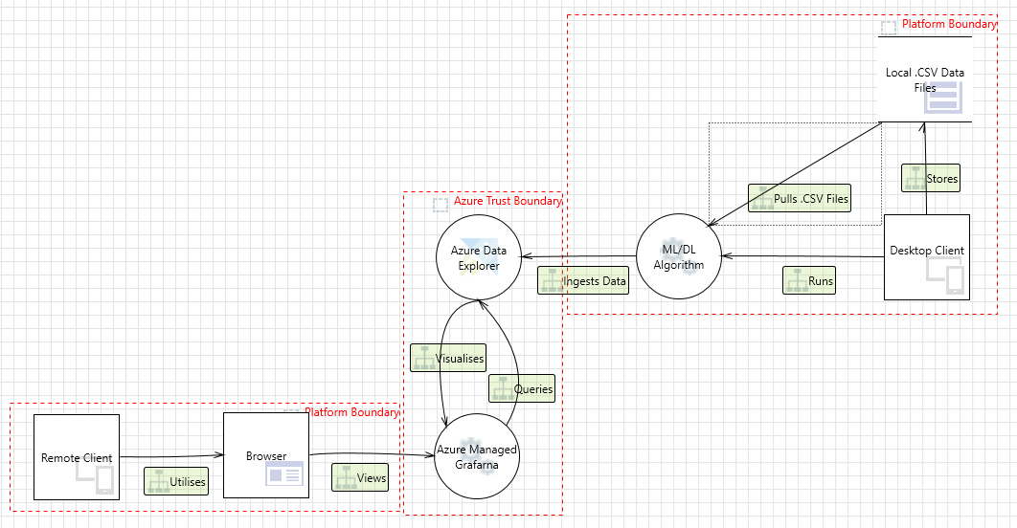
Pre-Deployment Testing Threat Model
Shows pre-deployment setup and cloud visualisation.
But data currently doesn't go through an AI algorithm pre-rollout
Therefore, things change, ready for a theoretical
rollout

